Slide 1
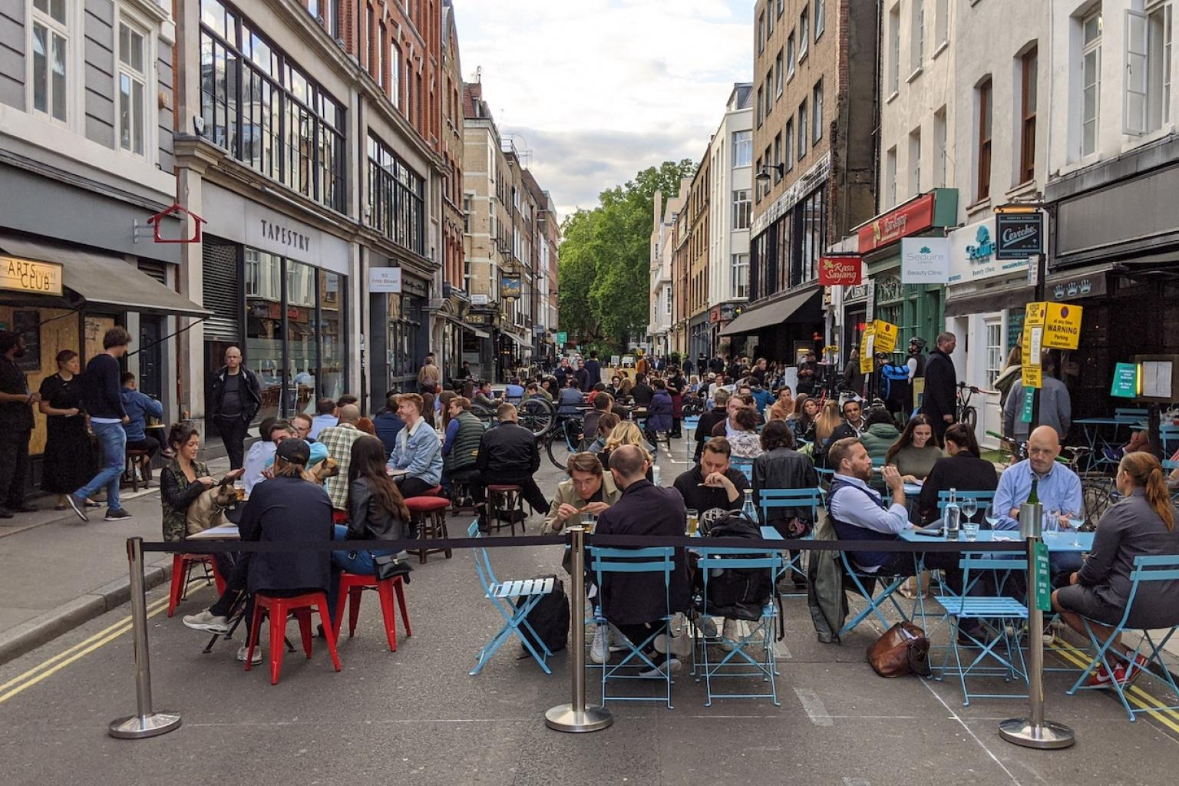
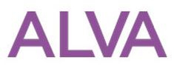
POWERED BY
UKH, BBPA, BII, TOURISM ALLIANCE & ALVA
VAT MEMBERS SURVEY 6.9.21 – 17.9.21

Slide 2
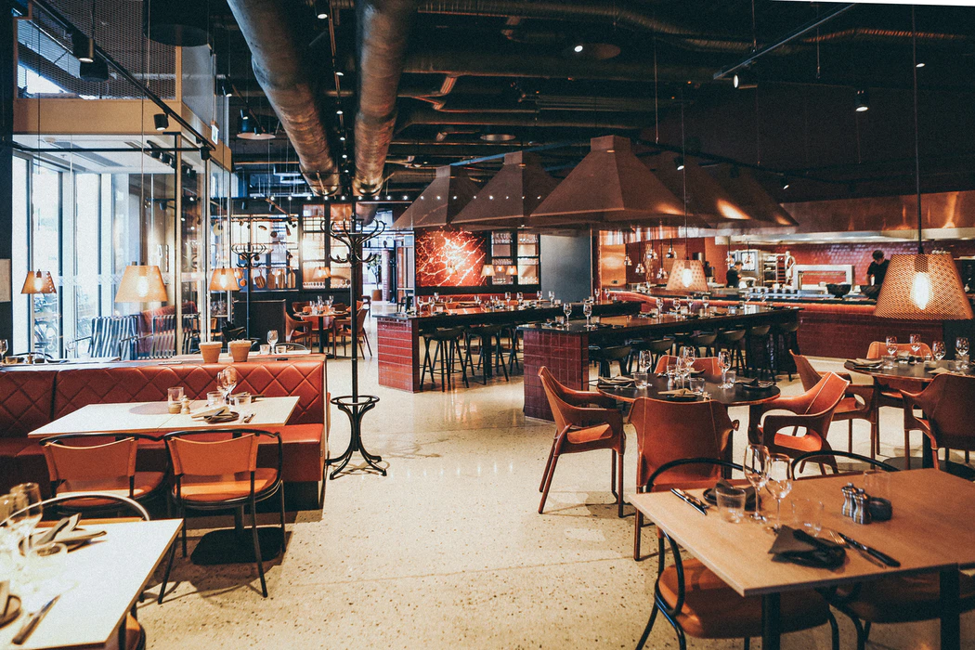
POWERED BY
METHODOLOGY AND SAMPLE…
Results collected between 6.9.21 – 17.9.21
Business type
Trade association membership
Overall responses:
815
Notes:
Tourism Alliance includes BH & HPA

Slide 3
POWERED BY
UKH, BBPA, BII, TOURISM ALLIANCE & ALVA VAT MEMBER SURVEY SEPTEMBER 2021
3 in 4
Businesses state the reduced VAT rate
of 12.5% will be important or crucial

Slide 4
POWERED BY
UKH, BBPA, BII, TOURISM ALLIANCE & ALVA VAT MEMBER SURVEY SEPTEMBER 2021
The reduced rate of VAT will be highly important to businesses, with 3 in 4 (77%) stating it is important or crucial
How important for your business is the reduced rate of VAT rate at 12.5% from 1st October to 31st March 2022 (compared to the full rate of 20%)?

Slide 5
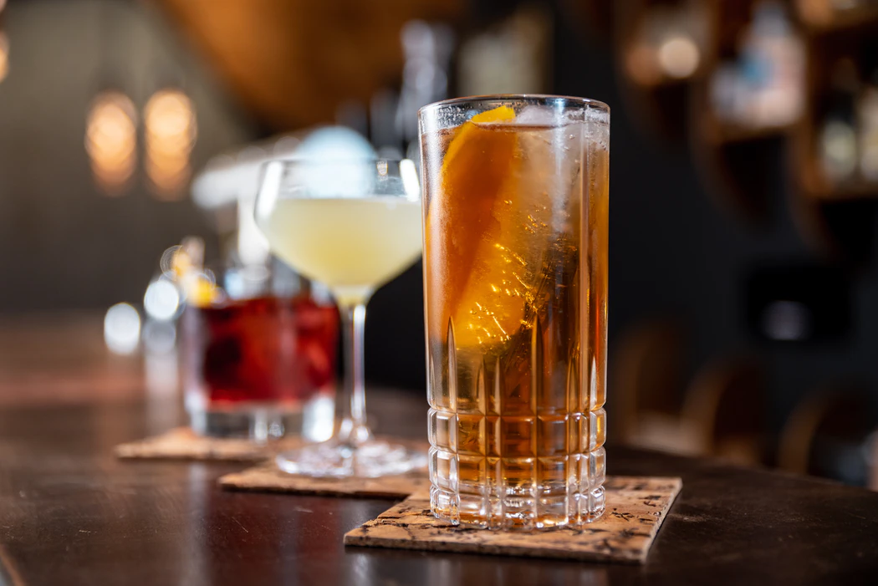
POWERED BY
UKH, BBPA, BII, TOURISM ALLIANCE & ALVA VAT MEMBER SURVEY SEPTEMBER 2021
Businesses will use the reduced VAT rate for an array of purposes, including investing in their businesses and remaining Covid-secure
In terms of the 12.5% rate that will be in effect from 1st October 2021 to 31st March 2022, for what purposes will your business use this reduced rate? Please select all that apply

Slide 6
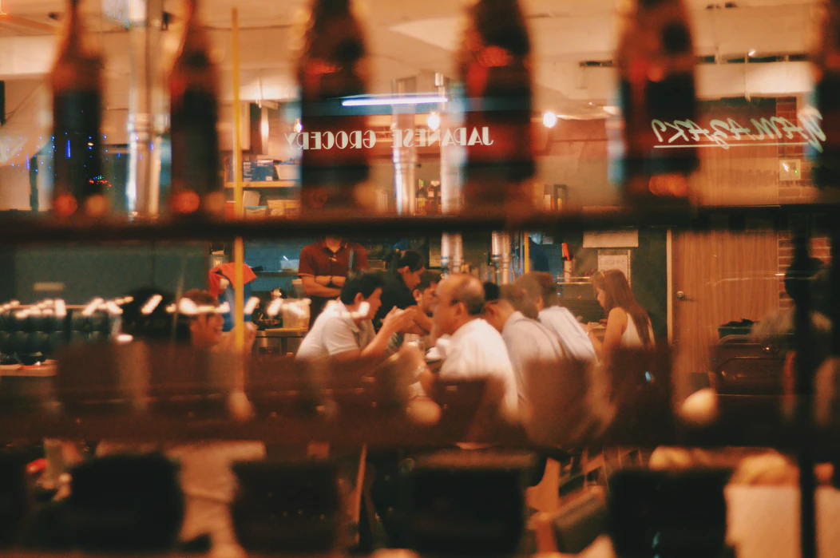
POWERED BY
UKH, BBPA, BII, TOURISM ALLIANCE & ALVA VAT MEMBER SURVEY SEPTEMBER 2021
If a 12.5% VAT rate were to continue to apply beyond April 2022…..
7 in 10
Would use the saved money to continue to
invest in their businesses

Slide 7
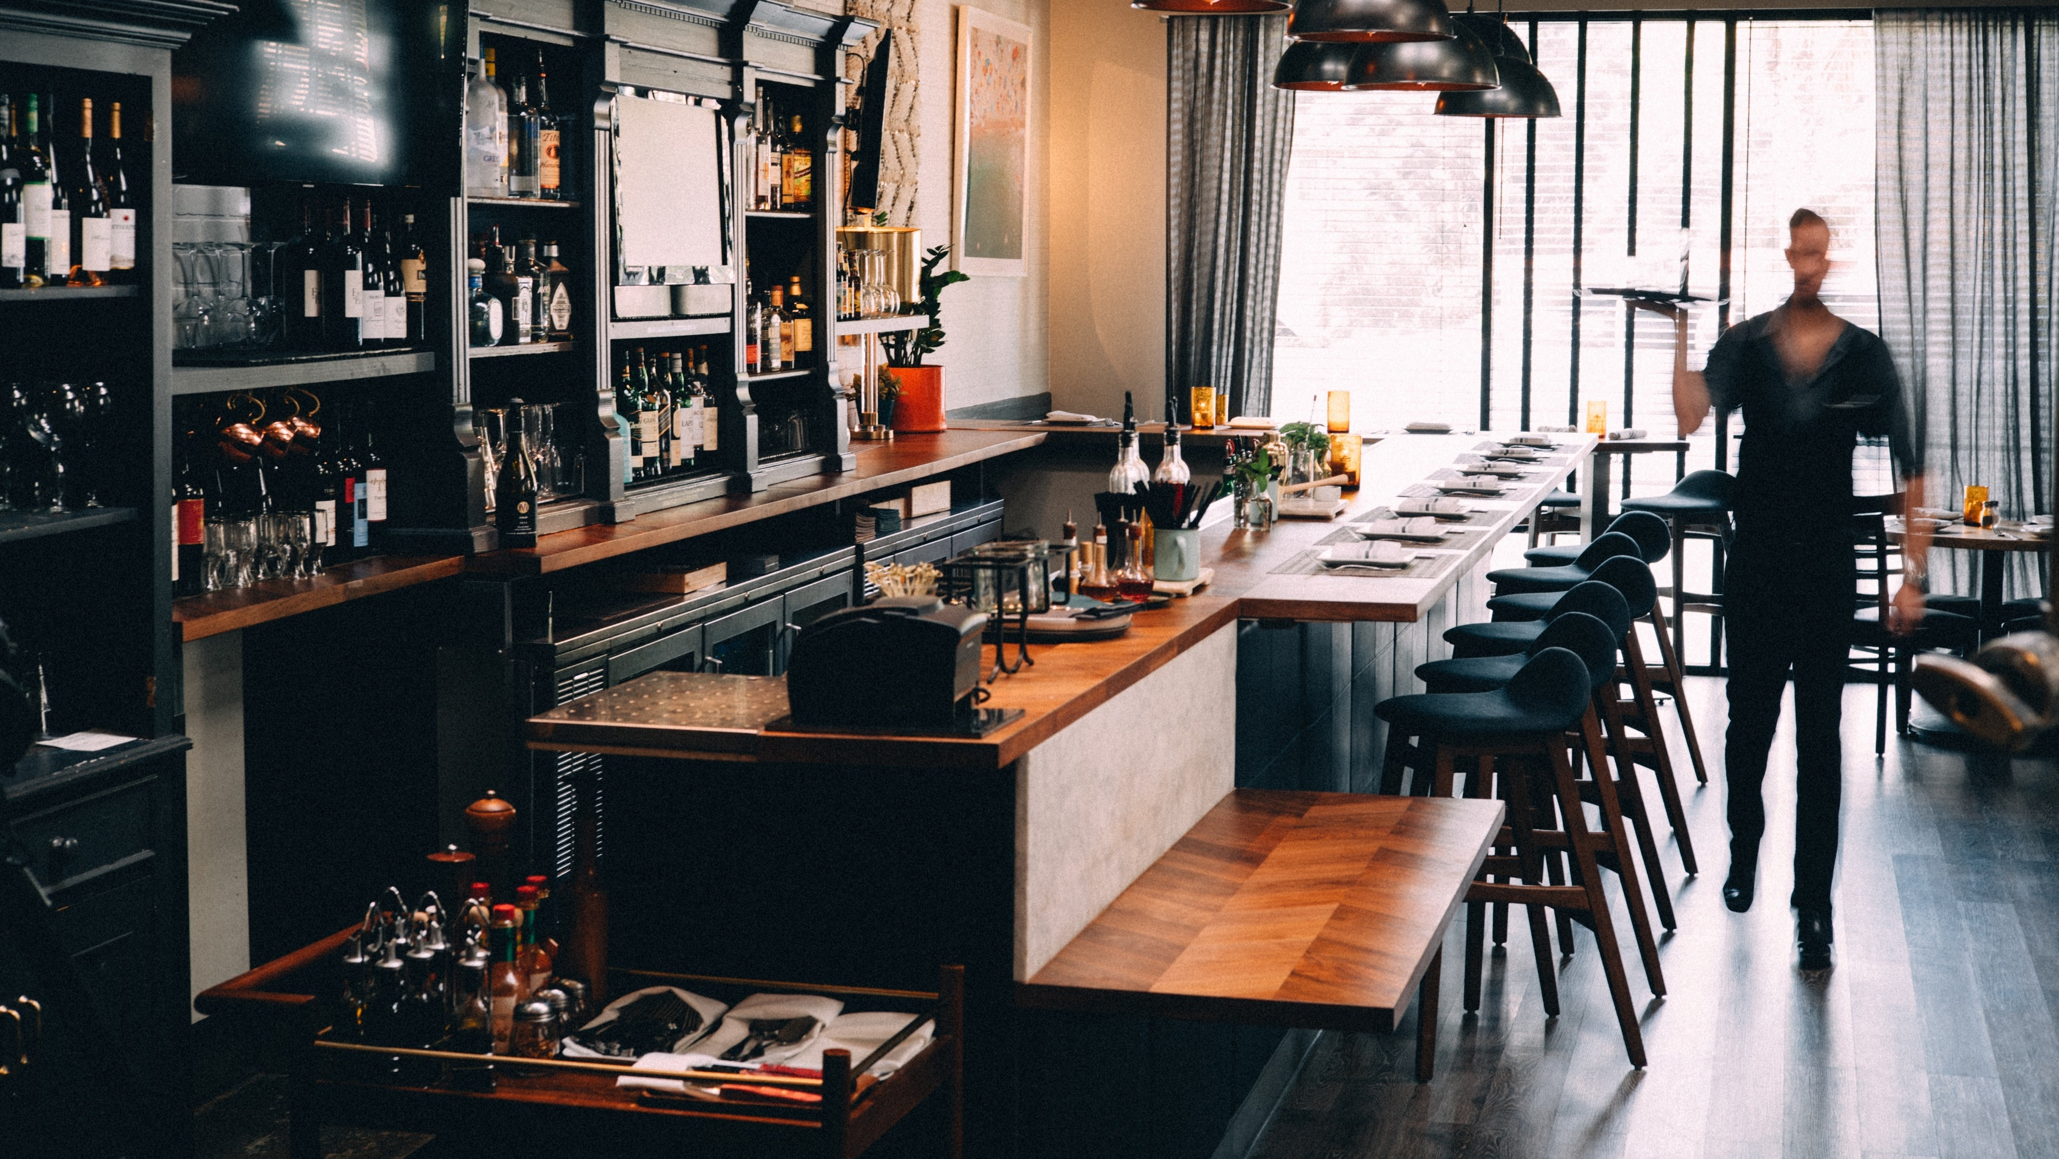
POWERED BY
UKH, BBPA, BII, TOURISM ALLIANCE & ALVA VAT MEMBER SURVEY SEPTEMBER 2021
Similarly, reduced rates beyond April 2020 would allow continued investment, covid-secure venues and paying of wages to staff
If a 12.5% VAT rate were to continue to apply beyond April 2022, for what purposes will your business use this reduced rate? Please select all that apply

Slide 8
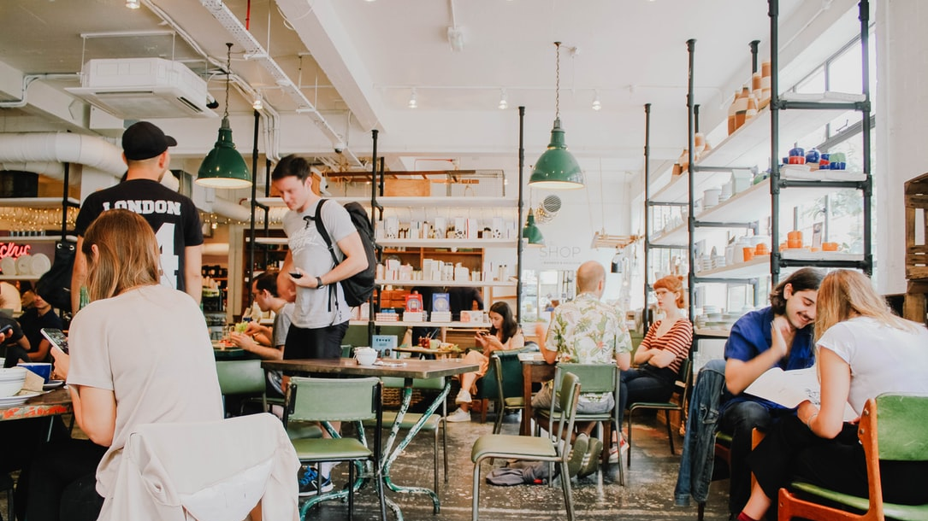
POWERED BY
UKH, BBPA, BII, TOURISM ALLIANCE & ALVA VAT MEMBER SURVEY SEPTEMBER 2021
If VAT is put back to 20% in April 2022…
4 in 10
Say it will likely lead to cutbacks and job losses

Slide 9
POWERED BY
UKH, BBPA, BII, TOURISM ALLIANCE & ALVA VAT MEMBER SURVEY SEPTEMBER 2021
Reverting the VAT level back to 20% in April 2020 could have serious consequences for businesses, with 4 in 10 saying it would likely lead to cutbacks and job losses
What will be the likely effect on your business if VAT is put back to 20% in April 2022?

Slide 10
POWERED BY
UKH, BBPA, BII, TOURISM ALLIANCE & ALVA VAT MEMBER SURVEY SEPTEMBER 2021
If VAT on tourism and hospitality were to remain at 12.5% indefinitely, it would increase turnover by an average of 8.8%
If it were to be announced that VAT on tourism and hospitality were to remain at 12.5% indefinitely, what impact do you think this would have on your turnover compared to a VAT rate of 20%?
+8.8%
Average estimate of increased business turnover

Slide 11
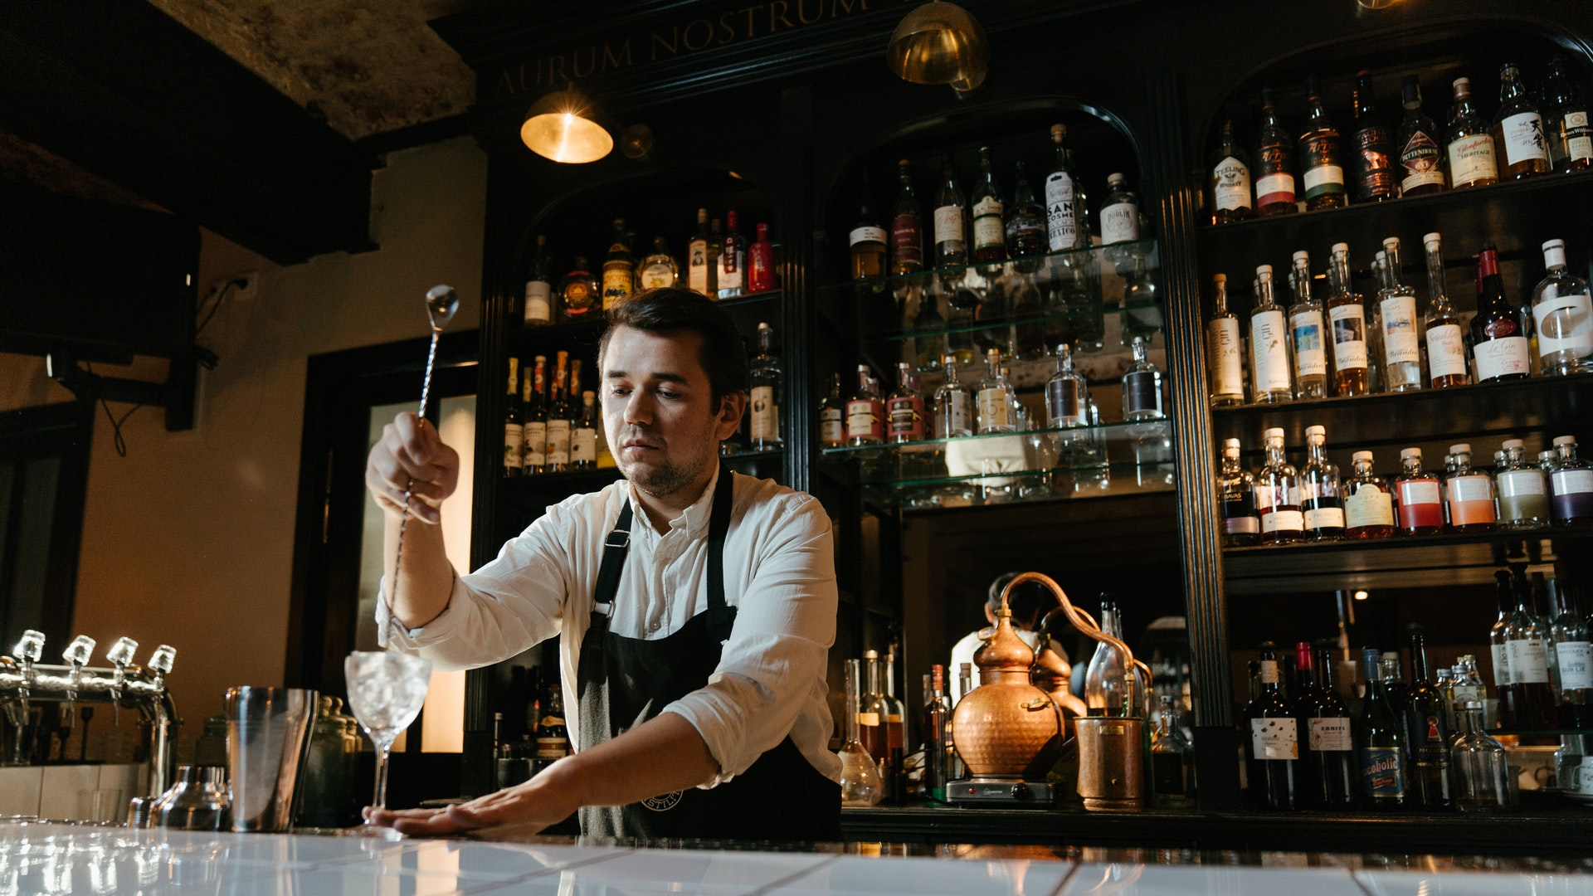
POWERED BY
UKH, BBPA, BII, TOURISM ALLIANCE & ALVA VAT MEMBER SURVEY SEPTEMBER 2021
Whereas if VAT on tourism and hospitality were to remain at 12.5% indefinitely, it would increase business investment by an average of 12.0%
If it were to be announced that VAT on tourism and hospitality were to remain at 12.5% indefinitely, how would this influence your attitude to investment in your business compared to a VAT rate of 20%?
+12.0%
Average estimate of increased business investment

Slide 12
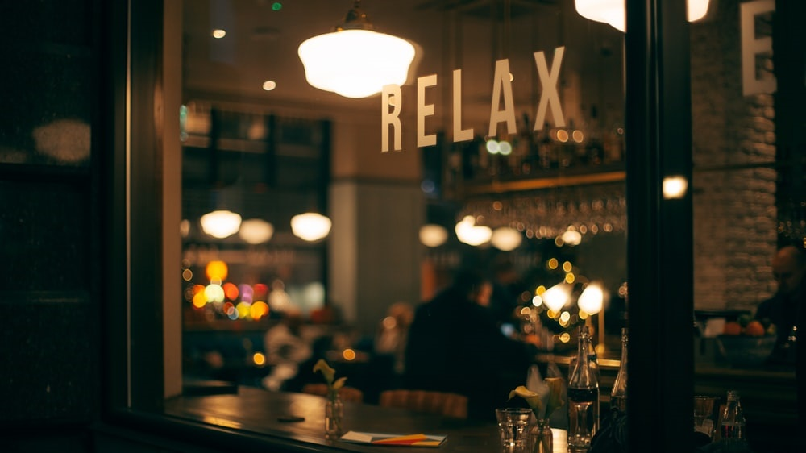
POWERED BY
UKH, BBPA, BII, TOURISM ALLIANCE & ALVA VAT MEMBER SURVEY SEPTEMBER 2021
Summary
The reduced rate of VAT at 12.5% will be highly important to businesses, with 3 in 4 (77%) stating it is important or crucial
Businesses will use the reduced VAT rate for an array of purposes, including investing in their businesses and remaining Covid-secure
Similarly, reduced rates beyond April 2020 would allow continued investment, covid-secure venues and paying of wages to staff
Reverting the VAT level back to 20% in April 2020 could have serious consequences for businesses, with 4 in 10 saying it would likely lead to cutbacks and job losses
If VAT on tourism and hospitality were to remain at 12.5% indefinitely, it would increase turnover by an average of 8.8%
Whereas if VAT on tourism and hospitality were to remain at 12.5% indefinitely, it would increase business investment by an average of 12.0%

